Slide 1

STYLEGAN
→
DIVERSE
Cross-Dataset Generalization
Adapting the deepfake detector to diverse fake types
Week 2 · Cross-testing & fine-tuning on the DFFD dataset

Slide 2

1
Where Week 1 left off
The Week 1 baseline
A ViT-Base/16 fine-tuned on the 140k Real and Fake Faces dataset reached 99.6% accuracy and a 1.000 ROC-AUC on its own held-out test set.
The catch we flagged
Every fake in that dataset came from a single generator — StyleGAN. So the near-perfect score likely reflected the model memorising one generator's fingerprint, not a general ability to spot fakes.
Which left one question for this week
Does the detector still work on fake faces it has never seen — made by entirely different methods?
OPEN QUESTION
Does it
generalize?
High in-domain accuracy can hide a model that fails the moment the fake type changes.

Slide 3

2
This week's objective
1 · Test transfer
2 · Then adapt
Run the Week 1 model, unchanged, on a different dataset built from fake types it never trained on.
Fine-tune the model on that new data and measure how much its generalization improves.
Hypothesis: a model trained only on StyleGAN fakes will detect unfamiliar fake types poorly — and cross-training should fix that.

Slide 4

3
The new dataset: DFFD
Diverse Fake Face Dataset (MSU) — real faces plus four fake families across two manipulation categories.
ATTRIBUTE MANIPULATION
ENTIRE SYNTHESIS
Edits part of a real face
Generates a whole face from scratch
FaceApp · StarGAN
PGGAN · StyleGAN
Real images = FFHQ. Crucially, the Week 1 model only ever saw StyleGAN synthesis — so FaceApp, StarGAN and PGGAN fakes are all new to it. That is what makes DFFD a real generalization test.

Slide 5

4
Method: a three-step experiment
1. Evaluate as-is
2. Fine-tune on DFFD
3. Re-evaluate
Test the Week 1 model on the DFFD test set, unchanged.
Continue training it on a balanced DFFD train split.
Test again on the same DFFD test set.
→ BEFORE
→ AFTER
Setup: same ViT-Base/16 architecture and metrics as Week 1 · balanced real/fake split · fine-tuned for 3 epochs at a low learning rate (1e-5) starting from the Week 1 weights.

Slide 6

5
The generalization gap (before)
Week 1 model, tested on DFFD without any changes:
31.25%
86.25%
100%
0.936
Recall (fakes caught)
Accuracy
Precision
ROC-AUC
It caught only about 1 in 3 fakes. Precision stayed perfect (it never mislabelled a real face), but it silently passed most FaceApp, StarGAN and PGGAN fakes through as 'real' — because it had only ever learned StyleGAN's fingerprint.

Slide 7

6
Closing the gap (after fine-tuning)
Same model, after fine-tuning on the diverse DFFD training set:
98.50%
98.90%
97.28%
0.9997
Recall (fakes caught)
Accuracy
F1 (fake)
ROC-AUC
Recall jumped from 31% to 98.5%. Once it had seen the new fake families during training, it detected almost all of them — recovering the fakes it used to miss, with only a small, expected dip in precision.

Slide 8

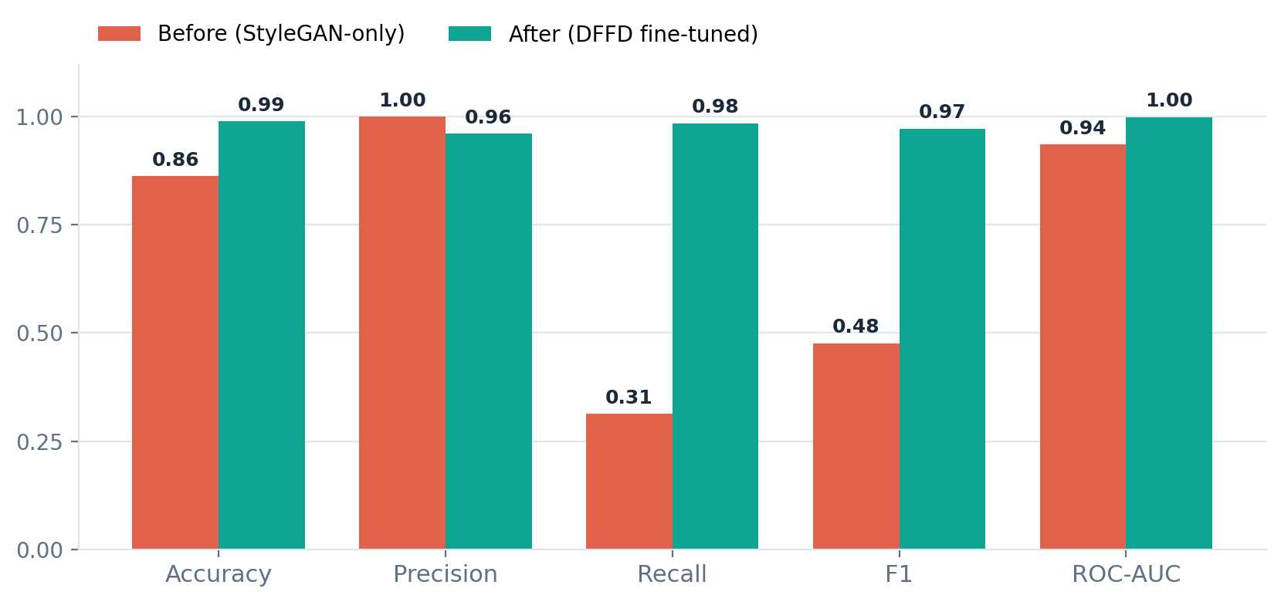
7
Before vs after
KEY CHANGES
Recall
+0.67
F1
+0.50
Accuracy
+0.13
ROC-AUC
+0.06
Precision
−0.04
Tested on 2,000 held-out DFFD images (fake = positive class).

Slide 9

8
What this means
Single-generator detectors don't transfer
A model trained on one fake type can score near-perfectly in-domain yet have large blind spots on other types. The headline number alone is misleading.
The failure mode is missed fakes, not false alarms
Precision stayed at 1.0 while recall collapsed to 0.31 — the model wasn't trigger-happy, it was quietly letting unfamiliar fakes through. That is the dangerous kind of error for a detector.
Cross-training closes the gap — at a small cost
Fine-tuning on diverse fakes lifted recall to 0.985. Precision dipped slightly (1.00 → 0.96), a worthwhile trade for catching far more fakes.

Slide 10
9
Limitations & caveats
Still one benchmark
Ran on a subset
DFFD is a strong test but a single dataset; broader claims need more sources.
Used ~4k images per generator for training and 2,000 for testing, to keep Colab runs fast.
Per-generator split not logged
Diffusion fakes still unseen
A file-tagging issue meant results couldn't be broken down by fake family this run — only overall metrics. Fix is pending.
DFFD's fakes are GAN- and app-based; diffusion-generated faces remain outside the model's experience.

Slide 11

10
Next steps
Per-generator breakdown
Add diffusion fakes
1
2
Fix the logging so we can see which fake family is hardest to detect.
Test on diffusion-generated faces (DeepFakeFace) — a family still unseen.
Video benchmarks
Robustness
3
4
Bring in FaceForensics++ and Celeb-DF via frame extraction and face cropping.
Evaluate under JPEG compression, blur and resizing — real-world conditions.
Explainability
Mixed-source training
5
6
Use attention / Grad-CAM maps to see what the model focuses on.
Train across StyleGAN + DFFD + diffusion together for broad coverage.

Slide 12
Week 2 — summary
Showed the generalization gap was real — then closed it by cross-training on diverse fakes.
0.31 → 0.99
0.48 → 0.97
+0.67
Recall on DFFD
F1 score
Recall gain
Delivered: evidence that a StyleGAN-only detector misses most unseen fakes, and a fine-tuned model that detects them across four fake families.
Next: per-generator analysis, diffusion and video benchmarks, and robustness testing.
Thank you

